Slide 1
TTS frontend: NLP as backbone of Audio synthesis
Zhiling Zhang
2019/12/11
Notes:
Hello everyone. Today I’ll talk about “XXX”.
Since the works I’ll introduce mainly focus on mandarin TTS system, I may use some Chinese when necessary.
/*
Hello everyone, I’m XXX. I’m a 4th year undergraduate student and it is my first time to give a presentation.
Today I’d like to talk sth. about Text-to-speech, or simply TTS. I selected this topic because I just ended an internship at the TTS group of Bytedance AI-Lab.
Actually, before that, I’m almost totally ignorant of the Speech field. I stated my preference as NLP in my application form to Bytedance, but was surprisingly picked by the Speech and Audio team. But after that, I found that the Speech field shares great similarity with NLP and NLP is in fact backbone of Audio synthesis. So I think this topic may also be inspiring to you.
*/

Slide 2
Outline
Introduction of production-level TTS system
Dig deep into TTS frontend
Basics
Paper from Bytedance: A unified TTS frontend
Conclusion
Notes:
This is the outline of the presentation. In case you’re unfamiliar with TTS systems as I was, I will give a brief introduction of TTS system. And I’ll dig deep into the TTS frontend, which is the focus of this presentation. I’ll use recent papers from bytedance to explain this part. Then I’ll give some conclusions.

Slide 3

Text-To-Speech(TTS) examples
“Turing Test”: Rate the following speeches according to their naturalness(e.g. human-like):
Sound 1:
Sound 2:
Sound 3:
Sound 4:
Sound 5:
Mean Opinion Score(MOS)
Standard evaluation metric for TTS
Notes:
First, I’d like you to take a “Turing Test” with me. I’ve prepared several sounds. Most of them are produced by TTS, but there is also real human voice. I want you to rate the following speeches according to their naturalness(e.g. human-like). [Since the sounds are already in production, even if you know some of them are TTS, please still rate them according to your true feeling.] https://www.wjx.cn/m/50511335.aspx

Slide 4

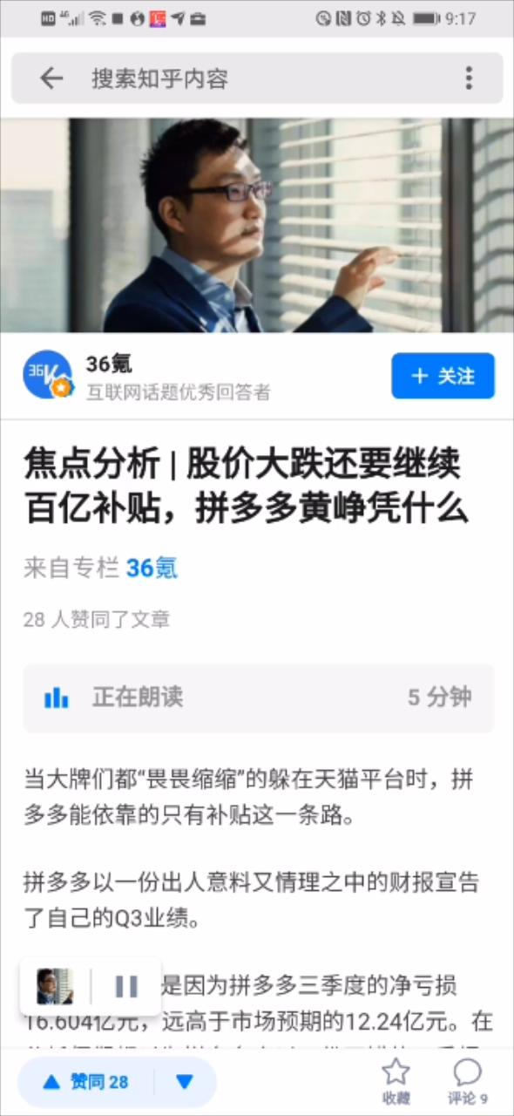
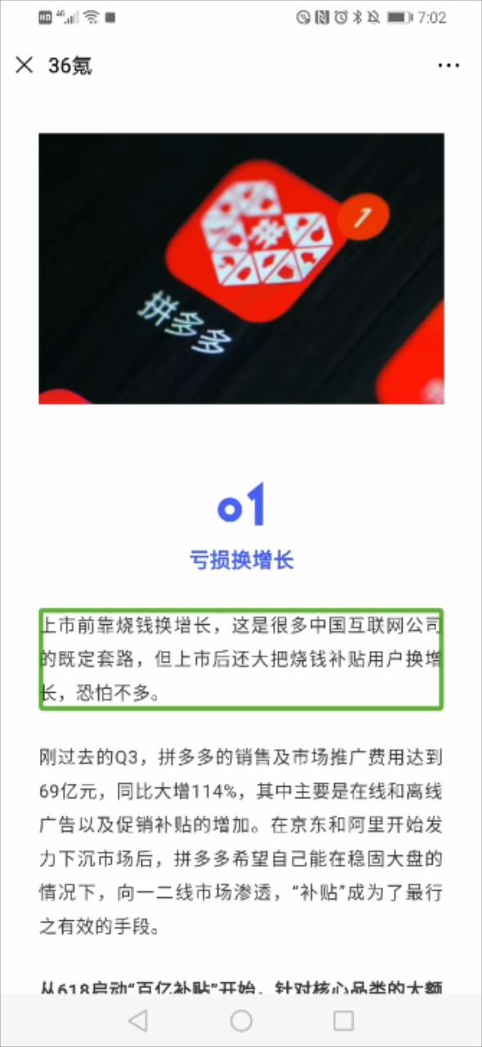
Text-To-Speech(TTS) examples
Sound 3
科大讯飞
iFlytek online engine
Sound 4
标贝科技
Human record
Sound 1
红果免费小说
Bytedance
Sound 2
知乎文章
Zhihu
Sound 5
华为无障碍
iFlytek offline engine
Notes:
Let’s reveal their true identity\(^o^)/~
These sounds also showed us the board application of TTS: news/book reading, Advertisement and Accessibility help for blind and uneducated people. For brevity, I didn’t put other applications here, like conversational robots and telephone sales.

Slide 5
Traditional TTS approach
At milk-tea shop:
请19取杯
Selection: 请| 十九 | 取杯
Retrieive: 请.wav | 十九.wav | 取杯.wav
Concatenate: complete wave
Drawback: Not fluent, memory usage, Hard to scale, …
No longer used in most systems, but can still be adopted in scenarios with low quality requirements.
Notes:
I first give a brief introduction of traditional TTS approach to give some intuition for the later part.
Have you ever queued up for milk-tea at 厝内小眷村 of 玉兰苑？ Then you may have encountered an TTS system.
We may find TTS systems for calling numbers in restaurants and hospitals, since the tasks there is simple, they usually use traditional TTS approaches.
3 steps: …
Selection: select how to read the sentence, here we divide the sentence into 3 parts, and specifically treat the number in the middle as 十九 instead of 一九
* In reality, usually phoneme-level concatenation, and 3-gram level granularity
However, if we want to extend these systems to synthesis arbitrary sentences, they will show their drawbacks.
As they are concatenations, there may be strange pauses in between or the volumes may be different. As a result, the produced wav may not sounds fluent.
And they heavily rely on existing recordings, so it will have to store all the possible units, and will require a huge memory, and thus it is hard to scale it to general world usage.

Slide 6
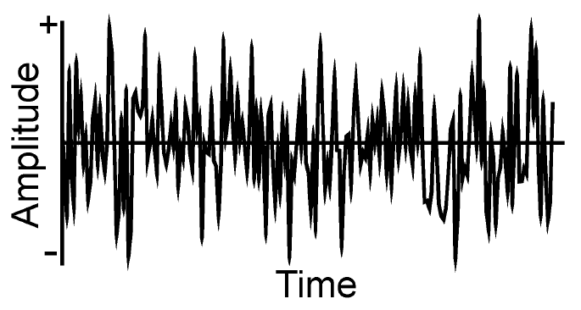
Modern TTS
Rethink: What is TEXT to SPEECH
The quick brown fox jumps over a lazy dog.
[2 1024 512 256 128 32 64 2048 4096 4...]
TEXT
Seq2seq?
SPEECH
Char/Word Sequence
huge difference
Sample point Sequence
（num_units, num_vocab)
Much longer
(24000*seconds , 2^16)
(num_samples, resolution)
Hard to model!
Notes:
Instead of concating existing sound clips, modern systems try to synthesis sounds with parametric models.
Let’s rethink what is TEXT to SPEECH. Text is a seq of words, and speech is also a seq, but consists of sample points.
So it’s like a seq2seq problem, but the property of the basic units are quite different. One is discrete and another is continuous.
And if we judge the size, we can find that speech is a much longer seq than text. So it’s hard to directly model the seq2seq translation.
Therefore, we usually don’t directly do the translation in an end2end way, but will divide it into 3 stages.

Slide 7
Typical TTS pipeline in production
Text
Frontend
Linguistic features
Backend
Acoustic
features
Vocoder
Wave
Frontend: produce Linguistic features [highly NLP]
Normalized text, phoneme, tone, prosody, etc. [details later]
Example shape: (40 chars, ?)
Backend: produce Acoustic features [NLP and Speech]
usually Mel Spectrogram
Example shape: (100 frames, 80 mel levels)
Vocoder: converts to wave [highly Speech]
Example shape: (72000 points, 2^16)
Closer relation
Closer shape
for each stage
Notes:
I won’t go through all the components for time limit.
I’ll focus the frontend, which is highly related to NLP.

Slide 8
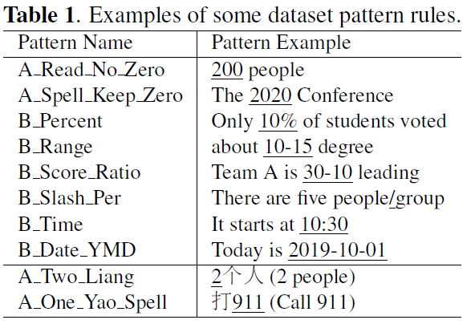
TTS frontend
Text Normalization
Text Normalization(文本归一化)
Normalized text
二百人
二零二零
百分之十
十到十五
三十比十
人每组
十点三十
二零一九年十月一日
两个人
九幺幺
WS & POS
Prosody
G2P
Backend
[1] Junhui Zhang et al. , A hybrid text normalization system using multi-head self-attention for mandarin, arXiv:1911.04128
Notes:
In natural Mandarin text, there are many things that not directly speakable or have ambiguous meanings, such as numbers and punctuations. So before TTS, we need to convert them into a more convenient form.
Remember the 请19取杯 example before? We use 19 instead of 1 and 9, and that’s a kind of TN.
I will give you more examples, and you will understand this immediately.
Formally, Text Normalization (TN) is a process to transform nonstandard words (NSW) into spoken-form words (SFW) for disambiguation.

Slide 9
TTS frontend
Text Normalization(文本归一化)
Typical solution(pattern based substitution)
text = “abc@demo.com”
text = text.replace(“@”, “ at ”)
text = text.replace(“.”, “ dot ”)
But, we can’t do “3.1415”.replace(“.”, “ dot ”)
Only use “dot” when “com” appears? Then we will lose “127.0.0.1”
Aggressive patterns may conflict, while conservative patterns may harm recall
Classify the pattern according to context[1]
If URL: replace(“.”, “ dot ”)
If Number: replace(“.”, “ point ”)
Text Normalization
WS & POS
Prosody
G2P
Backend
[1] Junhui Zhang et al. , A hybrid text normalization system using multi-head self-attention for mandarin, arXiv:1911.04128
Notes:
If you want to get more details, you can refer to paper below, a recent work of my bytedance colleagues.

Slide 10
TTS frontend
Text Normalization
WS(Word Segmentation，分词)
POS(Part-Of-Speech，词性标注)
Prosody（韵律）prediction
Decides the pause duration between spoken units
From shorter to longer:
#1 prosody word (PW)
#2 prosody phrase (PP)
#3 intonation phrase (IP)
#4 End of sentence (EOS)
E.g. 邓小平#2与#1撒切尔#2会晤#4。
沉鱼#1落雁#3，闭月#1羞花#4。
WS & POS
Prosody
G2P
Backend

Slide 11
TTS frontend
Text Normalization
grapheme-to-phoneme（G2P, 书写位转音位）
Grapheme: characters generally
Phoneme: the smallest unit of sound in a language which can distinguish two words
In Mandarin, 声母, 韵母 of 汉语拼音
Tone: 声调
In Mandarin, basically 4 + soft
Also 变调，儿化, more obvious in accents
E.g. 章志凌 zh ang 1, zh i 4, l ing 2
Main Challenge:
polyphone disambiguation[多音字消歧]
知之为知之，不知为不知，是知也。
WS & POS
Prosody
G2P
Backend
Notes:
According to dictionary, all 3 chars in my name has a unique pronunciation, so there is no need to “predict”. We just need to refer to dictionary.
The main challenge for the model is polyphones disambiguation.

Slide 12
TTS frontend
Text Normalization
grapheme-to-phoneme（G2P, 书写位转音位）
polyphone disambiguation requires context
Typical Solution:
Fixed-Window context classification
Example: window_size=6
WS & POS
Prosody
XXX
wei2
wei4
XXX
yi1
yi2
yi4
XXX
官指出，他们[为]心智成熟的人
G2P
共产党员应当[为]人民服务，才
Masked softmax
了你的吻，这[一]生原本一个人
Backend
，这一生原本[一]个人，你坚持
Word embeddings
+WS&Pos&Psd
Notes:
The left are the samples, we extract 6 chars on both sides, and use them to predict the phonenme of char in the middle.
We can extract features from the embedding and WS POS PSD, etc. And use models like transformer and BERT to do the contextualized prediction.
The right is the classes of labels. It’s a fixed number classification problem, and all characters would share the same set of classes. But we can know from dictionaries that the char only have several possiblities. So we would use a masked softmax to limit the prediction within the possible classes. Specifically, we will first get scores for all the possible phonemes and then we will mask out all the impossible dimensions, and only apply softmax on the possible dims.
In this example, …

Slide 13
Quiz: Spot TTS errors
Sound1: 但法官指出，他们为心智成熟的人…
Which type of error? (TN/G2P/Prosody?)
G2P error: 为(wei2 -> wei4)
Sound2: Duke, the No. 1 best college basketball team…
Which type of error? (TN/G2P/Prosody)
TN error: “No.” should be normalized as (Number)
Sound3: A lockdown was lifted at about 4 p.m. local time.
Which type of error? (TN/G2P/Prosody)
Prosody error: read as “at about 4 p.m.#4”, but should be #2
From an end2end model(with no explicit frontend), so no way to debug
Advantage with TTS frontend design
Easy to debug and apply fixes. Superior performance by now.
Notes:
Let’s do a quiz to review the previous concepts.
Actually, sound3 is produced by a model with no explicit frontend. So even if we’ve found the problem, we can not easily solve it.
But if we have frontend, we can simply fix it with a pattern. That’s an advantage of frontend design.
So even if we can adopt an end2end model, frontend design is still widely used.

Slide 14
TTS frontend
Text Normalization
Highly correlated parts
WS helps prosody
市/长江大桥， 市长/江大桥
市#2长江大桥， 市长#2江大桥
WS&POS helps G2P
市/长江大桥[LOC]， 市长/江大桥[PER]
市长(ch ang 2)江大桥， 市长(zh ang 3)江大桥
What if WS/POS makes error?
3 models needs to be trained separately
Need 3 set of labeled data, heavy labor
Unified G2P
WS & POS
Prosody
G2P
Backend
Notes:
Back to the frontend:
We found 3 highly correlated parts. They can help each other.
But the separate design have some drawbacks.
Here comes the solution, we purpose a unified model for them.

Slide 15
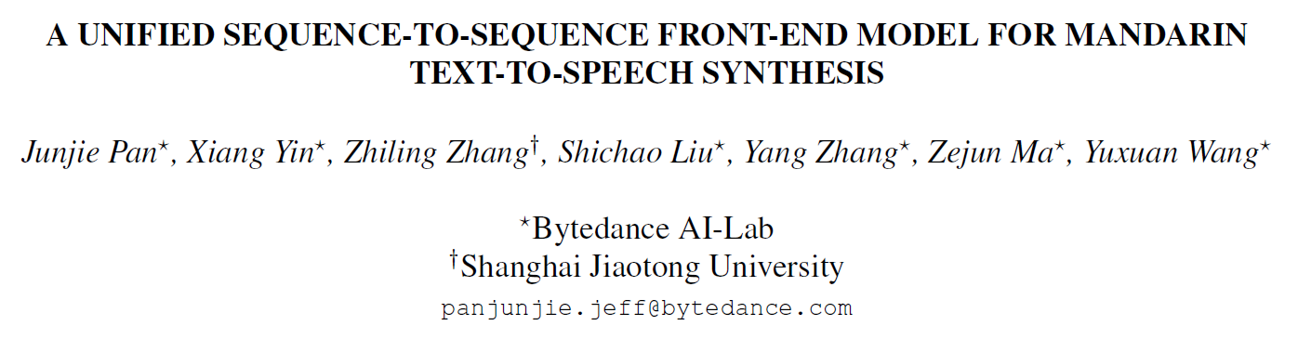
Submitted to 2020 ICASSP
[1] https://arxiv.org/abs/1911.04111
Notes:
It is not my major task here but I do contributed some code and experiments to this, so there is my name on it, hopefully it will be accepted.

Slide 16
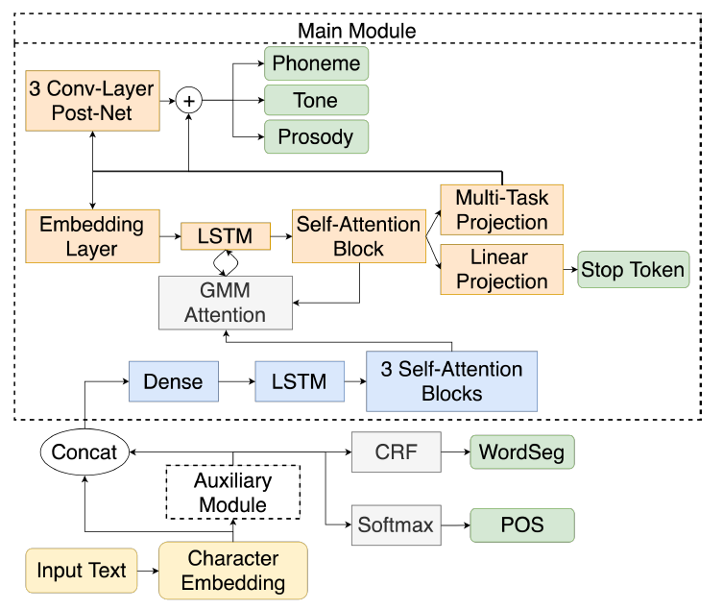
MODEL ARCHITECTURE
Notes:
This is the overall architecture. It’s complicated, so I will divide-and-conquer them and go through the key components.

Slide 17
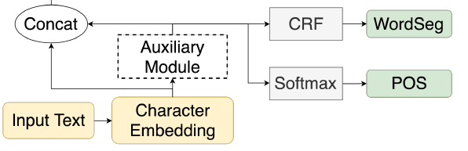
Auxiliary Module
Input: embedding trained from Word2vec
Model: Transformer Encoder
+CRF for WS, and +Softmax for POS
Output: WS/POS embedding
Values before the activation layers
mitigate the error-propagation
Embedding: [1.8, 1.9] (smooth)
Softmax: [0.475, 0.525]
Predicted: [0, 1] (hard)
Notes:
A trick here is the use of WS/POS embedding
For some situations like the example, the hard predicted label is so decisive that it can not reflect the true ambiguous semantic, so we use the embedding to mitigate the error-propagation.

Slide 18

Main Module
Encoder-attention-Decoder
Encoder: blocks in blue
Attention: GMM attention
Location-Relative, generalize to long utterances[details next]
Decoder:
Multi-task learning
4 objectives in green
PostNet
Fit the residual and added to the original decoder output to make prediction
$$y=f(x_{before}+x_{after})$$
Notes:
The main module is complicated, but we don’t need to struggle with the details. In essence, it an encoder-attention-decoder structure.
PostNet may be an unfamiliar concept to you because I seldom see this in NLP papers. Actually, it’s similar to Boosting, if you’re familiar with GBDT or xgboost. It fits….
It can be a universal design option, and you may try this

Slide 19
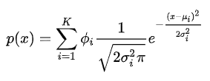
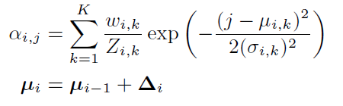

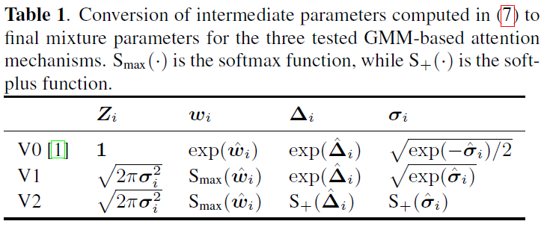

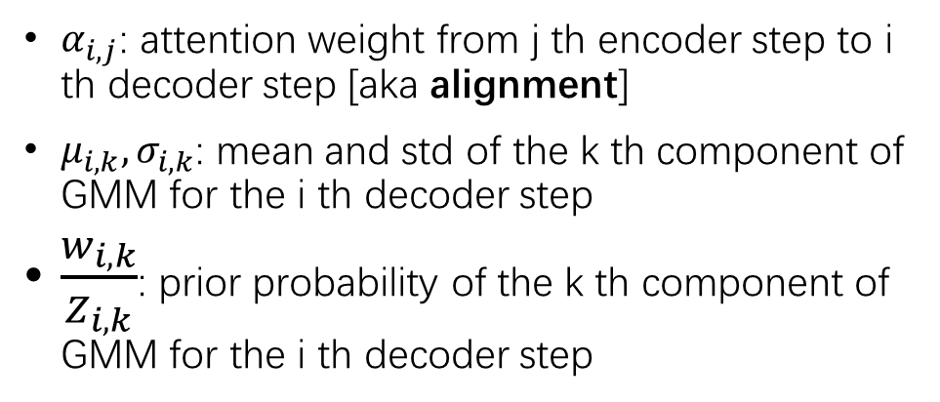
GMM attention
Classical GMM：
1
$α_{i,j}$: attention weight from j th encoder step to i th decoder step [aka alignment]
$μ_{i,k}, σ_{i,k}$: mean and std of the k th component of GMM for the i th decoder step
$\frac{w_{i,k}}{Z_{i,k}}$: prior probability of the k th component of GMM for the i th decoder step
2
3
[1] https://arxiv.org/abs/1308.0850
[2] https://arxiv.org/abs/1910.10288
Notes:
The main equations are the top 3, and the last table is the many choices of these parameters. I will skip them for simplicity, and give the key intuitions behind the main parameters and the 3 main equations.
It’s called GMM attention, because it is closely related to Gaussian mixture model.
Compare the first equation with the classical GMM, we may understand the meaning of the parameters.
They are similar, but here we use the probability for attention weight, as they both sum up to 1
It has a nice property, like the picture shows. It allows outputs to be much longer than inputs, so it is widely used in TTS, if you remember the change of magnitude for each stage of TTS.

Slide 20
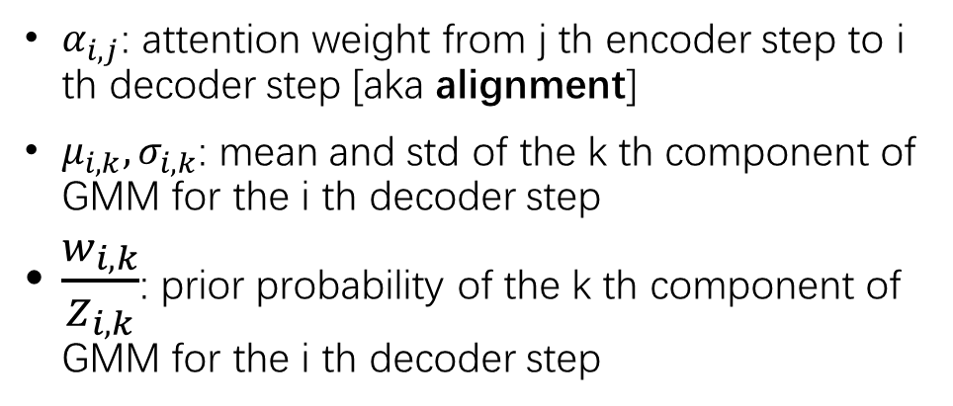
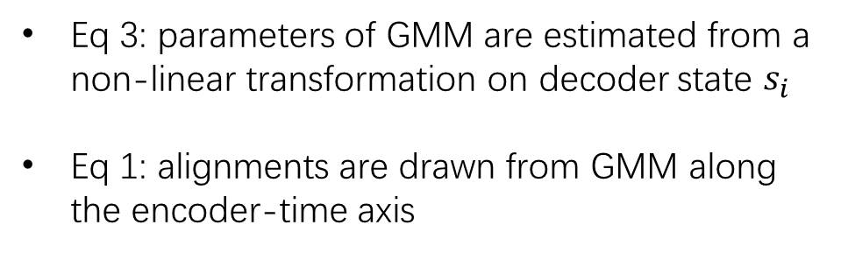
GMM attention
$α_{i,j}$: attention weight from j th encoder step to i th decoder step [aka alignment]
$μ_{i,k}, σ_{i,k}$: mean and std of the k th component of GMM for the i th decoder step
$\frac{w_{i,k}}{Z_{i,k}}$: prior probability of the k th component of GMM for the i th decoder step
1
2
3
Eq 2: Location-Relative modeling of GMM
Enforce monotonic alignment,
avoiding repeat patterns
Generalize better for longer decoding sequence than absolute models
Moving lower bound, smaller search space
Eq 3: parameters of GMM are estimated from a non-linear transformation on decoder state $s_{i}$
Eq 1: alignments are drawn from GMM along the encoder-time axis
[1] https://arxiv.org/abs/1308.0850
[2] https://arxiv.org/abs/1910.10288
Notes:
Take a closer look at the equations.

Slide 21
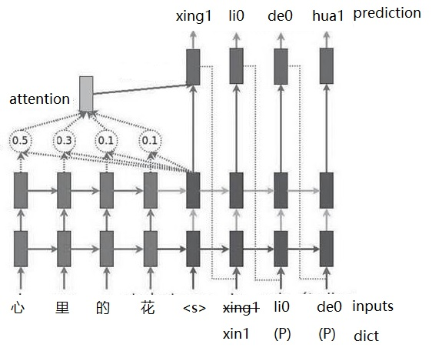
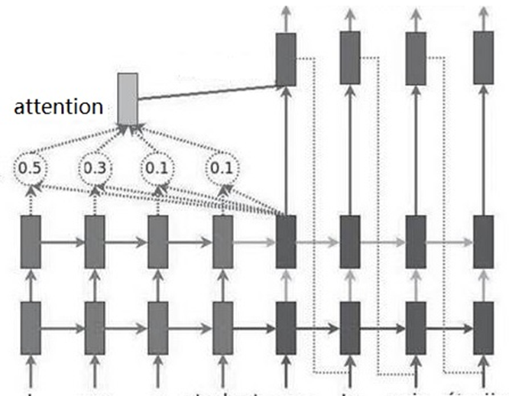
Semi Auto Regressive (SAR) Inference
We have to make prediction for every character in a Seq2Seq model. But since we already gold labels for non-polyphones, how can we use them to boost performance?
Directly feed them as the inputs.
At each decoder time step, we check whether the corresponding character in encoder is a non-polyphone.[1]
If this holds, we change the input of this step from the last prediction to the dictionary record.
[1] Achieved by a decoder mask generated from the raw input text.
illustration of SAR[(P) = Polyphone]
(My own drawing based on basic seq2seq)
Notes:
Here is an illustration of the typical seq2seq model. And it can reminds us that we have to …

Slide 22
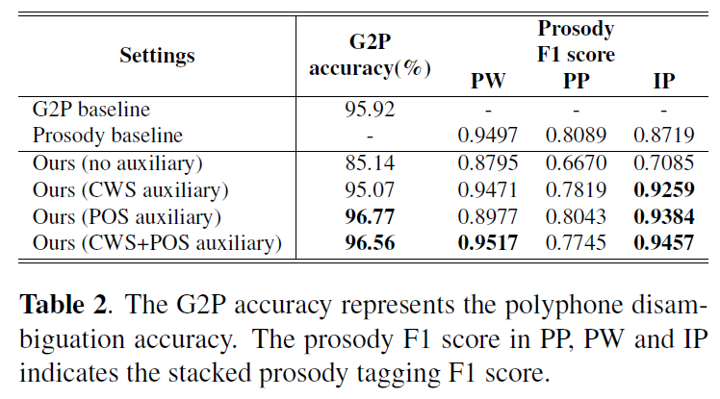
Experiments (Auxiliary module)
Lower half:
CWS+POS is essential for G2P
Upper VS Lower:
Multi-task learning achieves comparable performance with single models
Notes:
That’s all for the model structure and let’s see the results.
This table proves the effect of Auxiliary module.

Slide 23
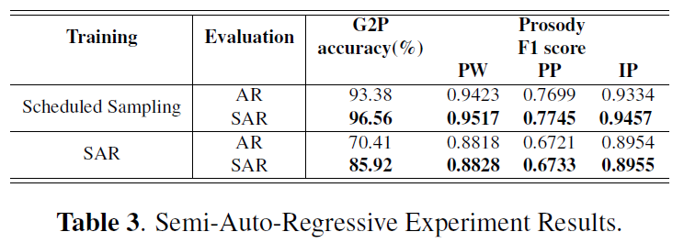
Experiments (SAR)
Each half:
using SAR in evaluation always helps
Upper vs Lower:
applying SAR in training severely degrades performance
Possible reason: When encountering continuous polyphones in test set, our front-end may generate incorrect phoneme if the phoneme from the previous step is already incorrect
[My view: heavily rely on ground truth, less robust to noise.]
Notes:
Scheduled Sampling is the default choice in training to mitigate train-test gap. It feeds the model with ground truth labels at a certain probability, and this probability decreases with the increasing training steps.
* SAR was strengthened with dictionary label, but performance enhancement should not be taken for granted. Because even if we feed truth to the inputs, the outputs may still produce wrong labels at next step, and we only calculate accuracy with raw outputs without postprocessing.

Slide 24
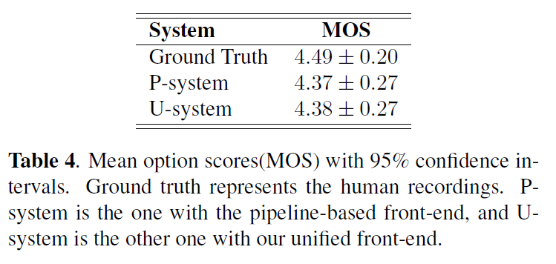
Experiments (in complete system)
P-system:
Traditional pipeline
U-system:
Proposed frontend
Integrated with
Tacotron backend
WaveRNN vocoder
Comparable result
Close-to-human

Slide 25
Conclusion
Production TTS system usually adopts frontend-backend-vocoder structure
TTS frontend usually consists of TN, WS, POS, Prosody prediction and G2P, which is highly related to NLP
NLP advances like attention, transformer, seq2seq have been introduced to TTS, and vice versa
ideas like ws/pos embedding, postnet, GMM attention may also be used in NLP
Don’t limit ourselves and get inspiration from cross-field learning

Slide 26
Thanks

